Slide 1
Probability & Statistical Modelling
AQ077-3-2-PSMOD and Version VD 1
Introduction and Overview

Slide 2
Lecturer information
Lecturer Name:
Email:
Telephone Extension:

Slide 3
Pre-requisites for this module
Mathematical Concept for Computing (AQ010-3-1-MCFC)

Slide 4
Aims of this module
The aim of this module is to equip students with the appropriate techniques to make predictions under uncertainty and make inferences about large populations from much smaller samples.

Slide 5
Course Learning Outcomes, CLOs
At the end of this module, YOU should be able to:
Discuss the fundamental of probability and statistical models (C2, PLO1)
Perform the statistical analysis using Excel output (A2, PLO6)
Determine appropriate probability and statistical models in solving problem (C4, PLO7)

Slide 6
Mapping of CLOs with MOEs
Domain
 | MOE | MOE | MOE | MOE | MOE | MOE | MOE | MOE | MOE | MOE | MOE
 | 1 | 2 | 3 | 4 | 5 | 6 | 7 | 8 | 9 | 10 | 11
CLO1
CLO2
CLO3
√
√
√

Slide 7
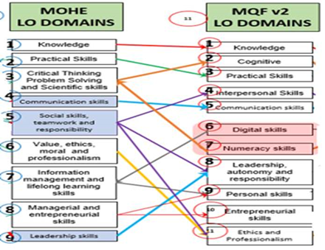
MQF and MOE Domains

Slide 8
Teaching Strategies
Situation | Teaching Activities | Learning Activities
LECTURE | Explanation, demonstration | Listen, take notes, accept, query, discuss with peers, one-minute paper
TUTORIAL | Give tutorial questions, demonstration and feedback | Learn from peers, critique, analyse, practice tutorial questions,

Slide 9
Assessment Methods
Incourse Assessment 50%
Quiz 1 10%
Hand in: week 3
Hand out: week 3
Return: week 4
Quiz 2 10%
Hand in: week 5
Hand out: week 5
Return: week 6
Practical Test 30%
Hand in: week 8
Hand out: week 8
Return: week 10
Final Exam 50%

Slide 10
Student Learning Time (SLT)
Module Credit Value: 3
Total Learning Hours:
Lecture: 1 time 2 hours per week
Tutorial: 1 time 1 hour per week
Practical:
Other:
Independent Learning Time:Students must be responsible for their own learning and define clearly independent learning time.

Slide 11
Methods of Delivery
Hence,
We are now moving from the traditional topic based teaching to outcome-based education

Slide 12
Outcomes Based Education (OBE)
OBE is education based on producing particular educational outcomes that:
Focus on what students can actually do after they are taught
Expect all learners / students to successfully achieve particular (sometimes minimum) level of knowledge and abilities.

Slide 13
So…What is OBE?
It’s
NOT
What we want to teach,
It’s
What You should learn

Slide 14
Course Content Outline
Chapter 1: Concept of Probability
Chapter 2: Summary Measures of Statistics
Chapter 3: Regression & Correlation
Chapter 4: Probability Distribution
Chapter 5: Estimation & Confidence intervals
Chapter 6: Hypothesis Testing
Chapter 7: Decision Making Techniques

Slide 15
What is expected of you
What is expected of you
You should abide to all the rules & regulation of APU
Proper attire
No speaking of dialects
Attendance is compulsory and valid medical certificates or letters from parents /guardians must support any absence from class.
Three lateness will be equal to one absence
All pagers and handphones should be turned off during lectures.

Slide 16
What support is available for you
Consultation hours
Resources
Reference material
Internet resources

Slide 17
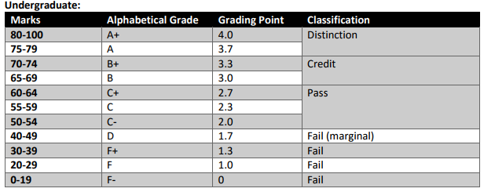
Achievement requirements

Slide 18
Question and answer session
Q & A

Slide 19
What we will cover next
Concept of Probability

